Slide 1

Introduction to IBM Watson Assistant
Session 1

Slide 2
What will be covered today
What is Watson Assistant?
The Watson assistant architecture
Relevant terms
Setting up a Watson Assistant virtual bot

Slide 3
What is IBM Watson?
IBM Watson was created in 2011 to answer questions on the quiz show Jeopardy! It was developed by IBM DeepQA.
IBM Watson Assistant is used to develop a live chatbot into any device, application, or channel. It was announced at THINK 2018 and launched later that year.

Slide 4
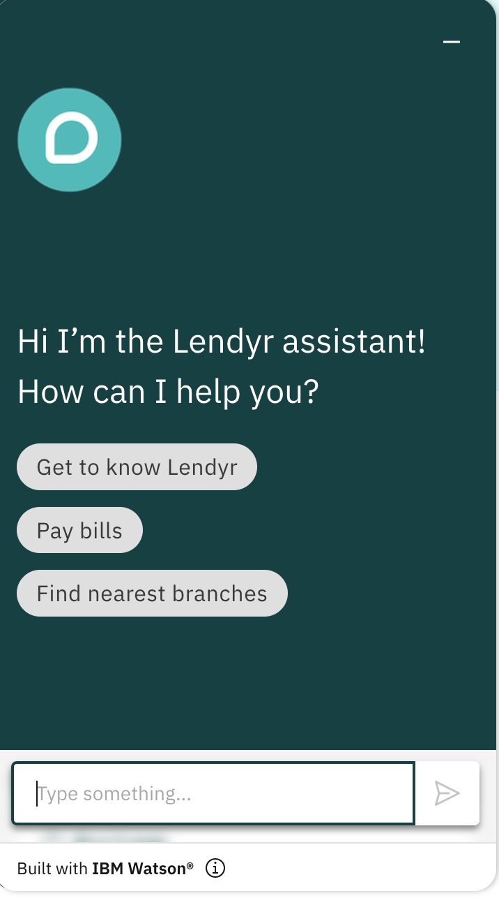
What is Watson Assistant?
Watson Assistant is virtual assistant to help customers with questions they may have.
It uses actions or dialog depending on what the use cases are.
Action is ideal to create a virtual assistant without any prior knowledge of machine learning or programming.
Dialog is ideal for use cases that require greater control over the logic. It uses an if then else style structure.
Notes:
https://cloud.ibm.com/docs/watson-assistant?topic=watson-assistant-comparing-actions-dialog
https://developer.ibm.com/articles/introduction-watson-assistant/
If then else will be in standard english and not any programming languages.

Slide 5
Use cases and what it isn’t meant to be used for
Meant for:
Automating customer queries without needing to call
Providing product support to customers with links/guides without needing human input
Preventing unnecessary calling customer services with questions that does not require
Not meant for:
Search engine queries
Providing undefined queries
Siri/Google Assistant products

Slide 6
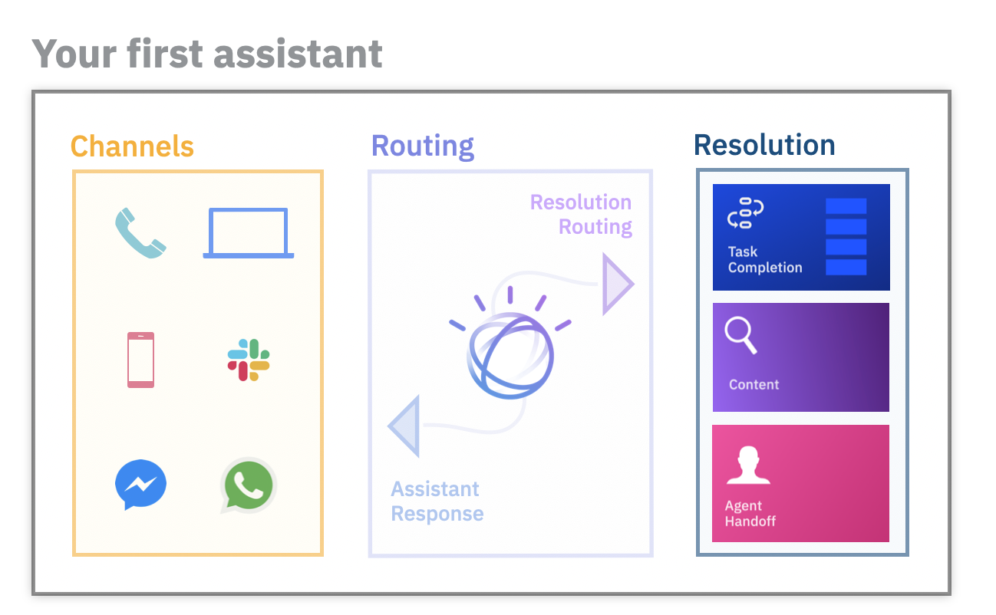
Facebook Messenger and Watson Assistant
We would be using Facebook Messenger as a message channel to communicate with Watson Assistant.
Feel free to use other channels if you would like to. However, some may requiring tweaking and editing.
Note: Some channels may require to pay

Slide 7
Some related technical terms
Boolean statements
Conditional statements

Slide 8
Introduction to Boolean Statements
A Boolean expression is a logical statement that is either TRUE or FALSE.
Boolean expressions can compare data of any type as long as both parts of the expression have the same basic data type. You can test data to see if it is equal to, greater than, or less than other data.

Slide 9
Introduction to conditional statements
Conditional Statements allow logical operations depending on the condition of the if statement.
Essentially, conditional statements would be helping the program to make a decision based on specified conditions.
Each choice or decision is based on the value a boolean expression.

Slide 10
Example conditional statements
“If you take this course, you will have a greater understanding of Watson Assistant”
This would mean that if you take this course you would have a greater understanding of Watson Assistant. However, if you do not take this course you will not have a greater understanding of Watson Assistant.
“If you do not drink water, you will be thirsty”
This would mean that if you do not drink water you will be thirsty. However, if you do drink water you will not be thirsty.

Slide 11
Setting up a Watson Assistant virtual bot
We will now be setting up Watson Assistant and creating an instance.
If you have any questions do feel free to ask me during the presentation.
A word document will be provided as well to assistant you as a recap.

Slide 12
Any questions?

Slide 13
Further Reading:
Conditional Statements:
Rosen, K.H. (2019) “1.13,” in Discrete mathematics and its applications. New York: McGraw-Hill, pp. 6–11.
Watson Assistant:
Demo Website: https://www.ibm.com/products/watson-assistant/demos/lendyr/demo.html
https://cloud.ibm.com/docs/watson-assistant?topic=watson-assistant-about
https://cloud.ibm.com/docs/watson-assistant?topic=watson-assistant-plan-assistant
Facebook Messenger:
https://cloud.ibm.com/docs/watson-assistant?topic=watson-assistant-deploy-facebook

